Slide 1
Advanced MATLAB Workshop
Vivek Sagar, PhD Candidate (NUIN)
July 12, 2019
Notes:
Check comfort level of the audience.

Slide 2
How do I make my MATLAB code better?
Basic moves
Function and function handles
Memory management
Big data tools
CPU parallel processing
GPU parallel processing
Mex codes
Notes:
The division of talk into two parts

Slide 3
How do I make my MATLAB code better?
Basic moves
First steps
Using MATLAB profiler
Pre-allocation
Vectorization
Fast referencing
Other simple tricks

Slide 4
A1. First steps
Designing the algorithm.
Some algorithms will perform worse than others on all programming platforms while others perform poorly on only specific platforms.
Examples?
Code structure:
Code readability – naming the variables/comments
Use functions in the script
Do not use too many nested functions in the script
Consider not using code when you can use data (for simulation)
Notes:
Example 1: Fibonacci sequence computed recursively.

Slide 5
A2. Profiler
Profiling can be used to time, optimize and debug the code.
Quick way to time the code: tic-toc
Reliable way: timeit
Check the performance of every aspect of code: profile
Other functions: cputime (do not use for wall-time performance), bench
We will discuss memory usage separately
Checkout: A2_profiling.m

Slide 6
A3. Pre-allocation
“For and while loops that incrementally increase the size of data structure through the loop can adversely affect performance and memory use”
Memory needs to be allocated at each iteration – BAD!
Improve code execution by allocation the maximum amount of space required.
Avoid overallocation – allocate large arrays first
Checkout: A3_preallocation.m

Slide 7
A4. Vectorization
Optimized for matrix and vector operations.
Better appearance, interpretability and less prone to human errors.
Runs much faster because of how the C-subroutines in MATLAB are designed.
Note: Using @arrayfun for applying a function to each element of matrix won’t usually help you (unless you use GPU)
Checkout: A4_vectorization.m

Slide 8
A5. Fast referencing
Faster to scan down columns that rows because MATLAB stores matrix data in column major order intrinsically.
Using vectorized subscripts to work with sub-matrices
Logical indexing for extracting elements
Short circuit logical operators || and && instead of or or and. Short circuit operators evaluate conditions serially.

Slide 9
A6. Miscellany
Avoid using clear all instead of clear in the scripts.
Decreasing the number of global/persistent variables
Organize the files so that you don’t have to cd within the script. Doing that needs code recompilation. Same applies to addpath, rmpath.
Avoiding eval, evalin – computing things from a written expression.
Avoid functions that query the state of MATLAB such as inputname, which, whos, exist(var).

Slide 10
How do I make my MATLAB code better?
Basic moves
Function and function handles
Memory management
Big data tools
CPU parallel processing
GPU parallel processing
Mex codes

Slide 11
How do I make my MATLAB code better?
Basic moves
Function and function handles
Simple function
Function handle
Anonymous functions
Sub-functions
Nested functions
Using persistent variables
Private functions
(OOP not covered)

Slide 12
B. Functions – why use functions?
Adds flexibility to the code
Clear idea of global variables used
Modular coding – interpretability (you can now (R2016b) add functions to the scripts like Python)
Easy on memory
To MATLAB for demonstration on different types of functions.

Slide 13
How do I make my MATLAB code better?
Basic moves
Function and function handles
Memory management – avoid memory wastage
Big data tools
CPU parallel processing
GPU parallel processing
Mex codes

Slide 14
Check MATLAB memory
Use task manager to check memory use in real-time
MATLAB memory command (only for Windows)
MATLAB workspace

Slide 15
Those annoying out-of-memory errors
Reduce memory usage
Use better data structures
Big data tools
OS might limit the memory use
Increase system swap space – swap space is additional memory on disk (but it’s painfully slow!)
To MATLAB for a demonstration.

Slide 16
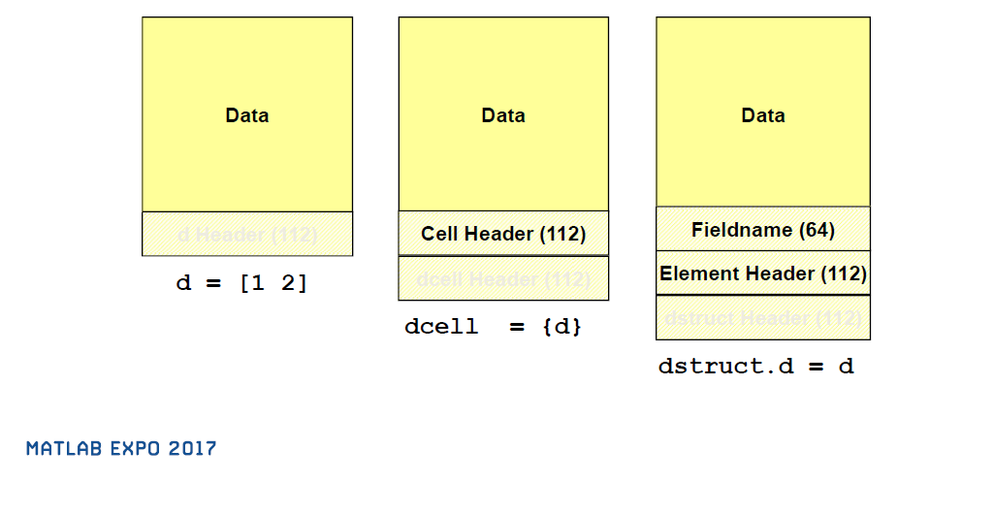
How are different data structures stored?

Slide 17
More data types - Tables
Similar to DataFrame in Pandas.
Can handle data and meta data.
Flexible indexing – { } like cells or .fieldname like structures.
Built in functionality like sort, merge

Slide 18
More data types - Categorical
For categorical data, convert a cell array of strings to categorical
More memory efficient
You can do set operations on them.

Slide 19
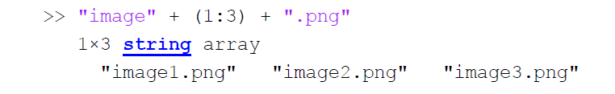

More data types – String instead of char
Use “ “ instead of ‘ ‘ to work with string arrays rather than character arrays.
Simplified text manipulation:
Performance: 50X faster in the previous example. 2X memory save using string than cell2str

Slide 20
More data types
Time series: datetime, calendar, timetable
Map containers: More like dictionary in python
Define your own “datatypes”

Slide 21
More Tips
Avoid temporary arrays
Avoid loading whole matlab workspaces and use only the variables you need
Proper use of nested functions
Avoid overallocation (pre-allocate large arrays first)
Save your data periodically on the disk

Slide 22
How do I make my MATLAB code better?
Basic moves
Function and function handles
Memory management
Big data tools – heavy memory use unavoidable
CPU parallel processing
GPU parallel processing
Mex codes

Slide 23
Big data tools
Datastore
Sparse, Tall and Distributed arrays
Work with MATLAB variables without loading full workspace into memory
Hierarchical data format
To MATLAB for a demonstration.

Slide 24
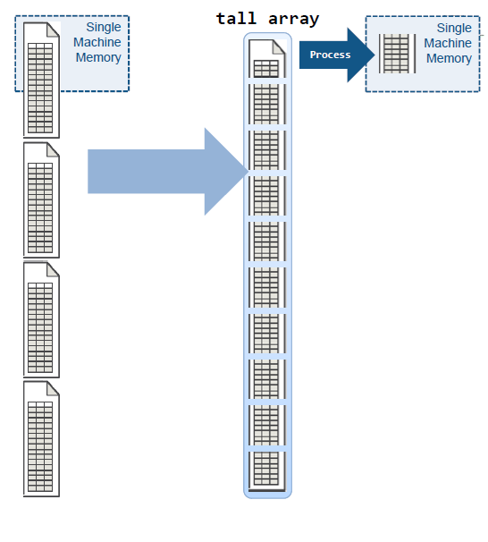

Tall Arrays
Automatically breaks data up into small “chunks” that fit in memory.
“Chunk” processing is handled automatically.
Processing code for tall arrays is the same as ordinary arrays.

Slide 25
More tools
Parquet: Efficient compression and encoding of column-oriented data. Enables compression schemes to be specified on a per-column level for efficiency
Memory Mapping: memmapfile maps a file or a portion of a file on disk to a range of addresses within an application's address space. Use for randomly accessing large files, or frequently access small files.
Map-reduce: Analyzing large data sets that otherwise cannot fit in your computer’s memory. Analysis on datastore can be done using mapreduce.
Distributed arrays

Slide 26
Part - II

Slide 27
How do I make my MATLAB code better?
Basic moves
Function and function handles
Memory management
Big data tools
CPU parallel processing
GPU parallel processing
Mex codes
Notes:
We are not discussing how problems are scaled on a cloud cluster.

Slide 28
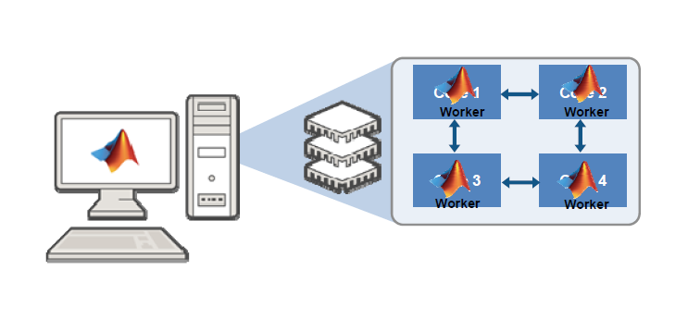
Leverage power of multiple cores
Notes:
Client and worker terminology.

Slide 29
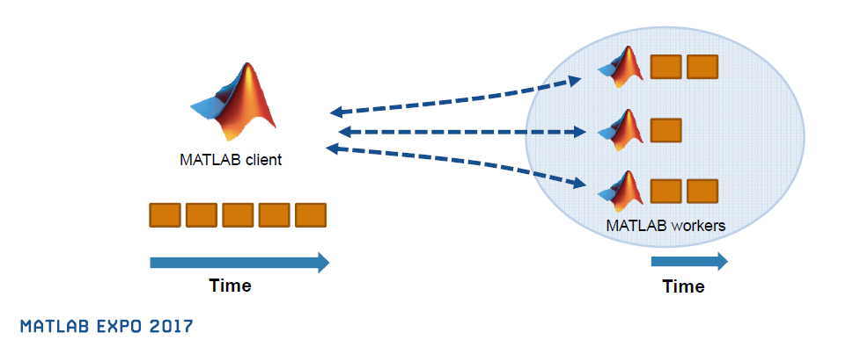
Which cuts down runtime for long loops.

Slide 30
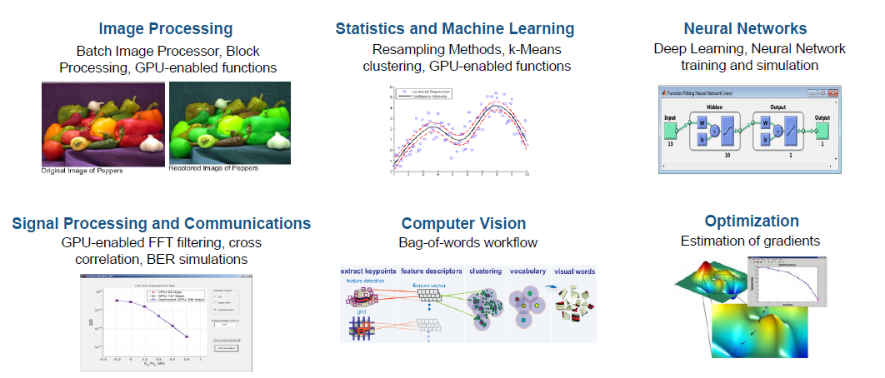
How to use parallel processing toolbox?
Check out the extended capabilities in the documentation for cpu/gpu parallel processing

Slide 31
Some parallel-processing jargon
Node: standalone computer, containing one or more CPUs / GPUs. Nodes are networked to form a cluster or supercomputer
Thread: smallest set of instructions that can be managed independently by a scheduler. On a GPU, multiprocessor or multicore system, multiple threads can be executed simultaneously (multi-threading)
Batch: off-load execution of a functional script to run in the background

Slide 32
Not all tasks can be parallelized…
When individual iterations of a loop are independent of each other
No communication between iterations
Difficult to keep track of the sequence of iterations
Serial loops can be faster if they are small – parallelization has a cost

Slide 33
Parfor por favor
Some for loops in MATLAB can be parallelized by using parfor.
By default, running commands like parfor, spmd, batch start “parpool” or the parallel processing pool automatically.
Can’t have nested parfor.
Can only work well for “sliced” variables. Else “broadcasted” causing large overhead.
The first level of indexing is either parentheses, (), or braces, {}.
Within the first-level parentheses or braces, the list of indices is the same for all occurrences of a given variable.
Within the list of indices for the variable, exactly one index involves the loop variable.
The array maintains a constant shape.
MATLAB client and MATLAB workers use different random number generators.

Slide 34
Batch processing
Use batch jobs to off-load the execution of long-running computations in the background.
For batch jobs, MATLAB can be closed on the client, and the client can be shut down when the batch job is submitted to another computer or cluster.
Particularly suitable when you are working on a compute cluster.
To MATLAB for a demonstration.

Slide 35
Other parallel coding commands
spmd – control each worker separately with a specific labindex
labindex, labsendreceive – commands to control a unique work for asymmetric calculations
parfeval, parfevalOnAll – for asynchronous parallel programming. You can evaluate a function in the background without waiting for it to complete.
To MATLAB for a demonstration.

Slide 36
How do I make my MATLAB code better?
Basic moves
Function and function handles
Memory management
Big data tools
CPU parallel processing
GPU parallel processing
Mex codes
Notes:
We are not discussing how problems are scaled on a cloud cluster.

Slide 37
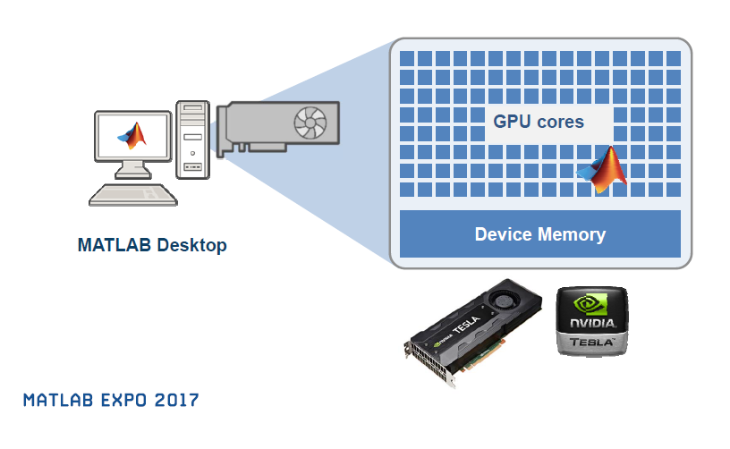
There are no GPU “workers” in GPU parallel processing

Slide 38
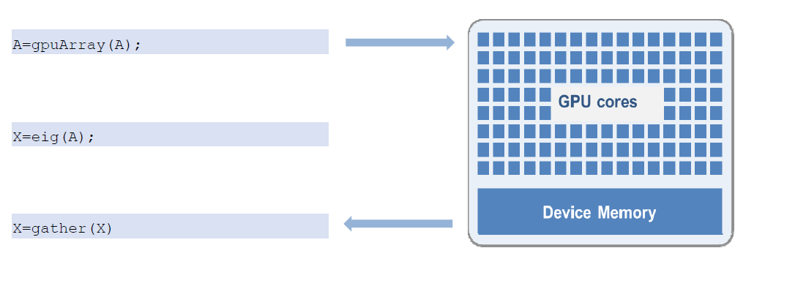
Basic workflow
Transfer data from CPU to GPU
Perform calculations in the usual way
Get the data from GPU

Slide 39
When to use GPU?
Massively parallel: The computations can be broken down into hundreds or thousands of independent units of work.
Computationally intensive: The time spent on computation significantly exceeds the time spent on transferring data to and from GPU memory.

Slide 40
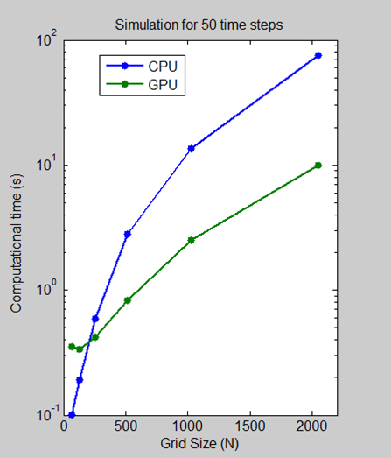
CPU vs GPU for solving 2D wave equation:
To MATLAB for a demonstration.

Slide 41
How do I make my MATLAB code better?
Basic moves
Function and function handles
Memory management
Big data tools
CPU parallel processing
GPU parallel processing
Mex codes

Slide 42
Why translate MATLAB to C?
Implementing C codes on the hardware
Integrating MATLAB with existing C environment
Prototype MATLAB algorithms as standalone executables
Accelerate MATLAB algorithms
Ideally need an automated way of translating the code: Enter “MATLAB Coder toolbox”
Notes:
Leads to multiple implementation of the same code if done manually. Slow. Error prone.

Slide 43
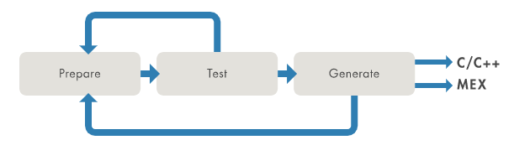
Recommended Three-Step Iterative Workflow

Slide 44
But remember these differences between C and MATLAB
Memory allocation. In C code, memory allocation is either static, dynamic or stack that needs to be defined.
Array-based language. C code requires explicit for-loops instead of array operations.
Dynamic typing. MATLAB automatically determines the data types and sizes as the code runs.
Polymorphism. MATLAB functions can support many different input types. A single line of MATLAB can have multiple meanings!

Slide 45
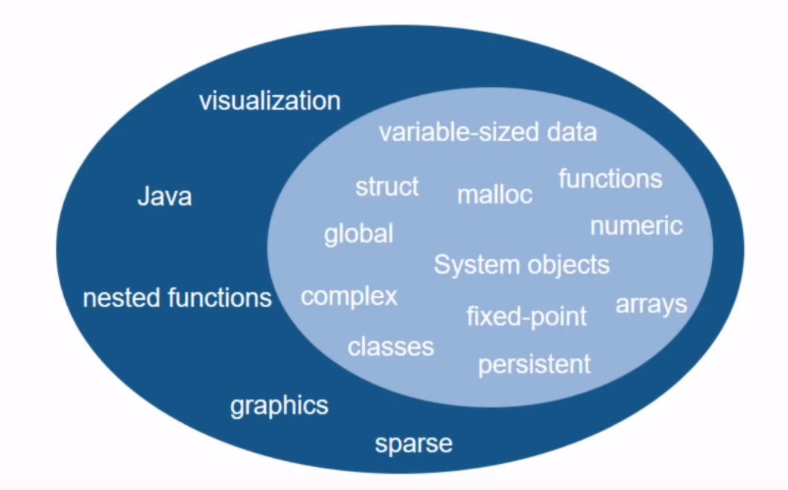
Can I change every MATLAB code to C?
Only some aspects of MATLAB supported…
To MATLAB for a demonstration.

Slide 46
No
Tall arrays
Does it fit in memory?
Big data
Distributed arrays
Yes
Big data or faster processing?
Use Batch to offload to cloud
gpuArray
Parfor, spmd
Faster processing
No
Yes
Yes
Profile, vectorize, use basic steps
GPU?
Multi-core?
No

Slide 47
Resources:
Master-class: Advanced Programming Techniques in MATLAB
Parallel Computing with MATLAB
Loren on the Art of MATLAB
MATLAB to C made easy

